Slide 1
Forecasting Diabetes
By diagnostic measures
Yuka Kudo

Slide 2
Topics
Model overview
Diabetes types
assumptions
Feature creation and data cleaning
Model selection
Augmentations
Challenges

Slide 3
Model Overview
The objective of the dataset
To diagnostically predict whether or not a patient has diabetes, based on certain diagnostic measurements.all patients here are females at least 21 years old of Pima Indian heritage
Dataset
Samples size: 768
Diabetes 268 / Non Diabetes 500 [1:2]
Predictor variables: 8 variables
The number of times pregnant, Plasma glucose concentration a 2 hours in an oral glucose tolerance test, Blood Pressure, 2-Hour serum insulin (mu U/ml), BMI,Diabetes Pedigree Function, Age
Model and method chosen
Random Forest for classifying
ROC and AUC for viewing F1 score
Class_weight, Resampling for imbalanced data

Slide 4
Diabetes types
Type 1
This type occurs most frequently in children and adolescents
Genetic/Ethnic influence Ex : American Indians(this dataset) , African Americans, Hispanics/Latinos etc
Type 2
This type occurs in adults and accounts for around 90% of all diabetes cases
Tendency : Heart and blood vessel disease,Overweight
Gestational diabetes
High blood glucose during pregnancy
Usually disappears after pregnancy but women affected and their children are at increased risk of developing type 2 later in life

Slide 5
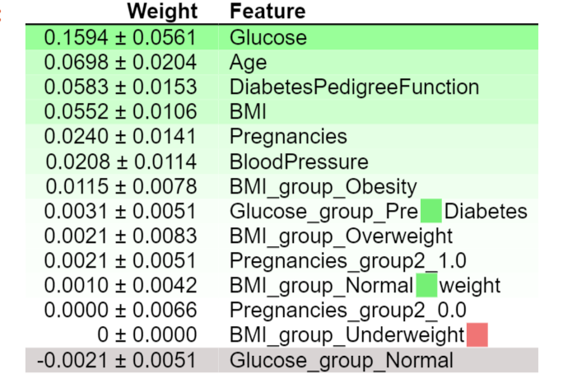
Assumptions
“High blood pressure” + “BMI over 30” = Diabete?
Being pregnant many times = Diabetes?

Slide 6
Feature creation and data cleaning
Create new Features
BMI group
Underweight below 18.5, Normal weight = 18.5–24.9, Overweight = 25–29.9 , Obesity over 30
Glucose group
Normal Below 140 , Prediabetes 140 - 199 (mg/dL ), Diabetes over 200
Pregnancies group
Zero or more than once
Remove
Insulin and Skin Thickness features
Insulin(374) and Skin Thickness(227). Most of observations miss both of values.
Missing data
Take Median for BMI, blood pressure, Glucose

Slide 7
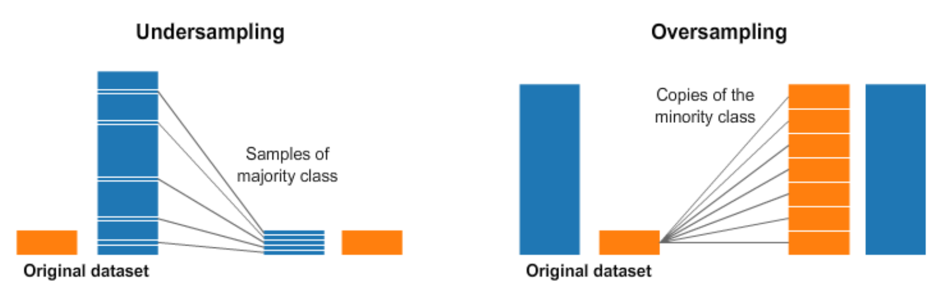
Model Selection
Handling imbalanced data
Improve F1 score (Precision and Recall Average), Not accuracy!
Set class_weights
Resampling ( SMOTE and Undersampling)
Evaluation of models
ROC and AUC

Slide 8
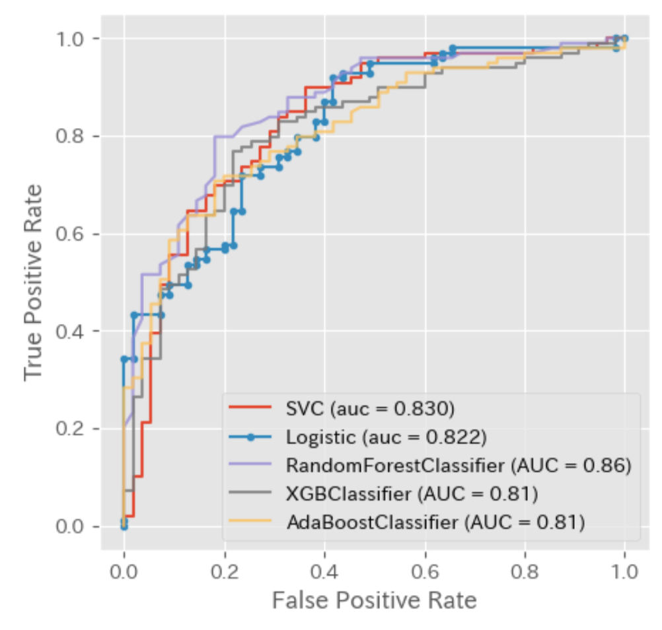
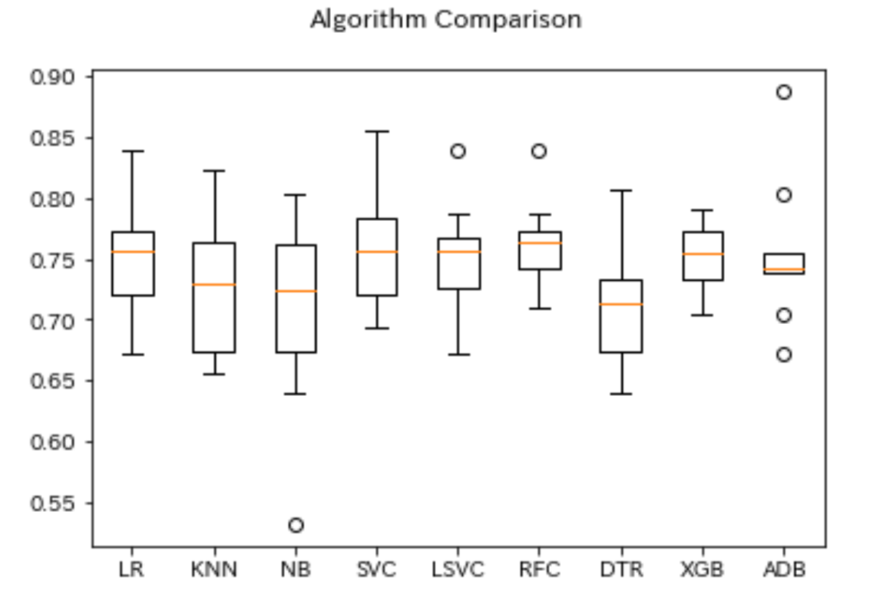
Model Selection

Slide 9
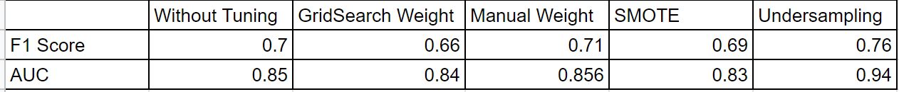
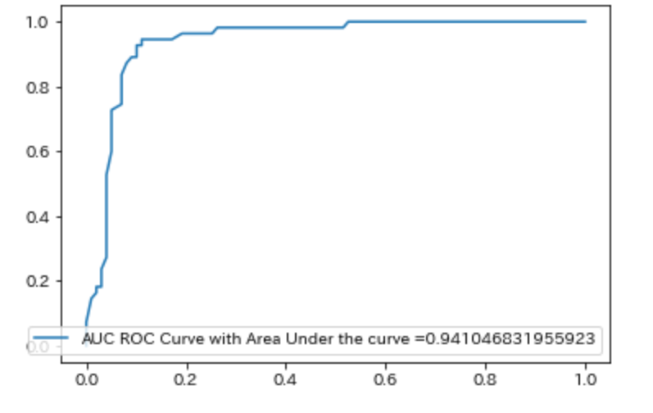
Model Selection
Undersampling method
Random Forest Algorithm
Accuracy = 0.768361581920904
Precision = 0.7640449438202247
Recall = 0.7727272727272727
F1 Score = 0.768361581920904

Slide 10
Model Selection
False Positive(Model classify as Diabetes but it is actually NOT diabetes)
Age : older than 37 years old 88%
Pregnancies: Yes 77 %
BMI_group_Obesity 77 %
Glucose pre diabetes 77 %
False Negative(Model classify as not Diabetes but it is actually diabetes)
Age : 20s 55%, 30s 30%, 40s 15%
Pregnancies : Yes 80%
BMI obesity or overweight 95% (BMI_group_Obesity 55% , overweight 40% )
Glucose Normal 90%

Slide 11
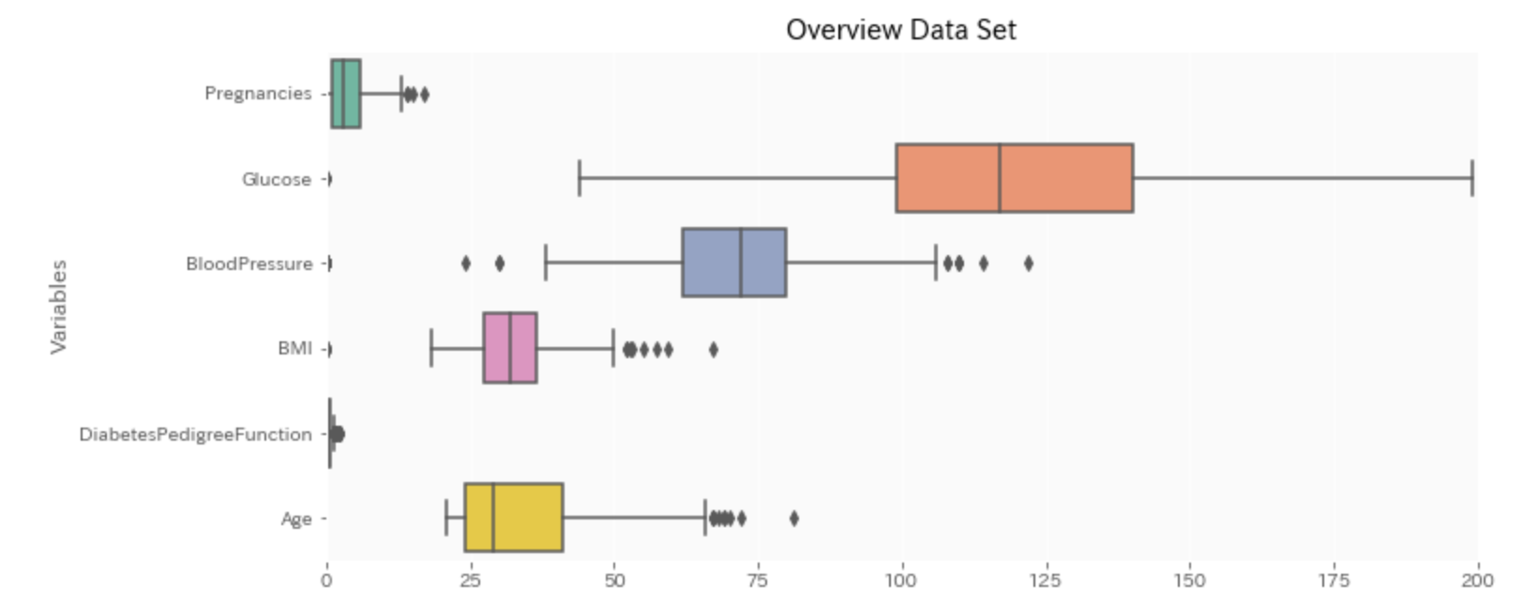
Augmentations
With additional time I would do the following:
Study deeper on features of FP and FN and create new features to improve F1 score
Collect more observations
Would be interesting to know if labels are detailed (Type1, Type2, Gestational)
Explore different methods for handling imbalanced data resampling (ex: ENN, Hybrid of Random over + under sampling)
Handling outliers (Blood Pressure)

Slide 12
Challenges
Datasets
The number of observations is small
Imbalanced data
Missing insulin data which could be important feature(based on domain info)
How Diabetes Pedigree Function was created

